Slide 1
Automation of Configuration Management
Process Improvement project

Slide 2
Brief
COBRA engines run through some configurations containing configurable parameters.
Each COBRA instance has multiple such configs.
Each region has multiple such instances.
Similar case for scripts and files.
Approximately 6000

Slide 3
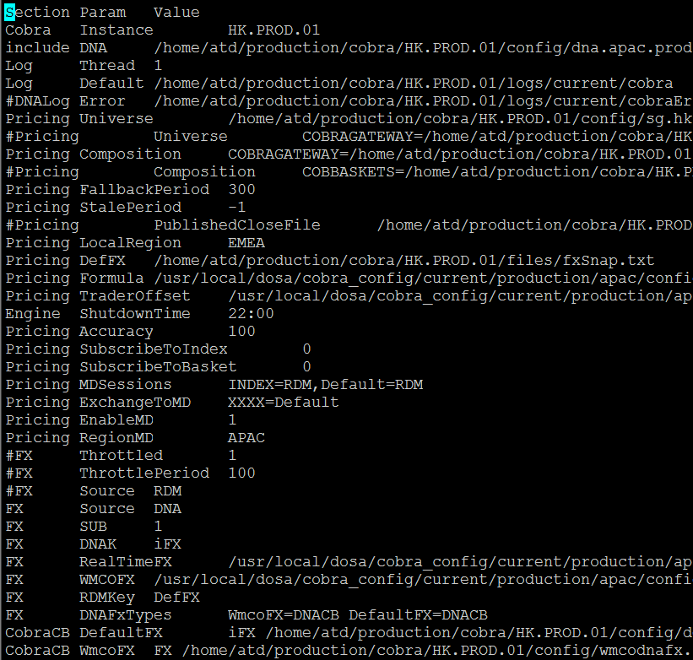
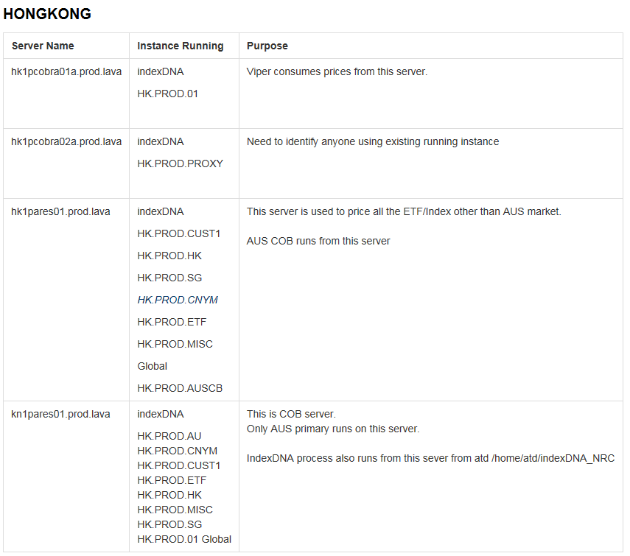
Screenshot of a config
Screenshot of list of instances
Notes:
Screenshot of a config and list of server/instances

Slide 4
Current Scenario
Manual management of these configurations.
Change in a entry or a new entry to config causes a huge trouble.
This change is then released to production involving a lot of manual steps.
Release steps overview.
Notes:
For developer: Bring configs from PROD, make entries in each config, ensure no mistakes are made, make a release packet and then make release steps corresponding to the same.
For support: Go to each instance, take the backup of config which involves a change, copy the new config, repeat the same for all the configs and then again for all the instances.

Slide 5
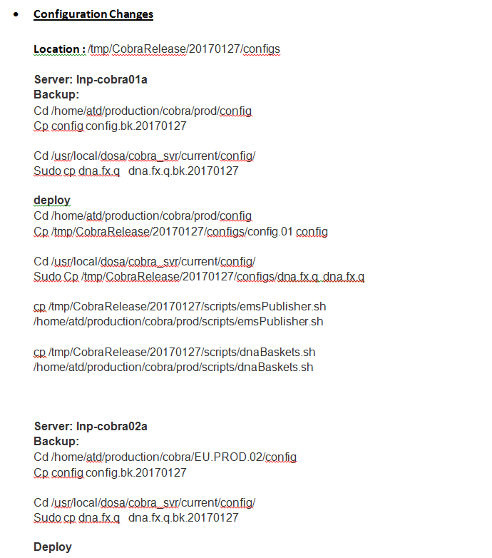
Screenshot of old release and rollback steps
Notes:
Screenshot of old release steps

Slide 6
Solutions
Addressed this problem with a Release Script as a temporary solution.
It was an interactive script which asked various questions and deployed configs, scripts and files for multiple instances running on multiple servers.
This scripts did both release and rollback and was a temporary fix for the problem.

Slide 7
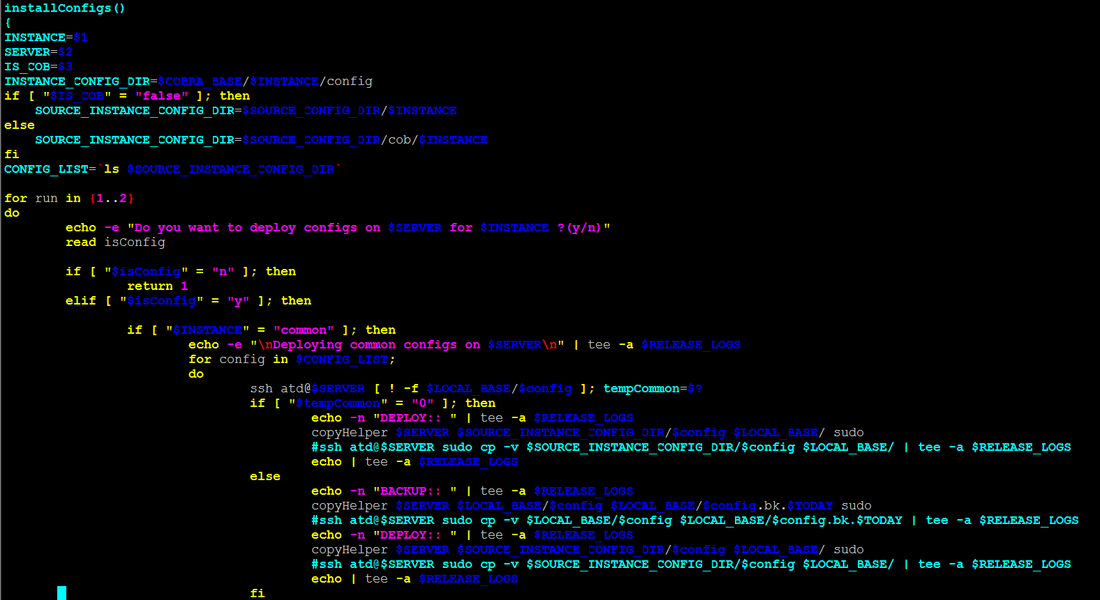
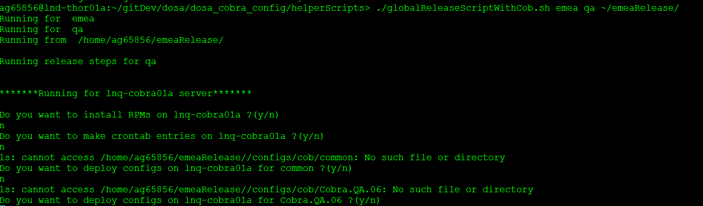
Screenshot of a function of release and rollback script
Screenshot of interactive questions
Notes:
Screen shot of release script and interactive questions

Slide 8
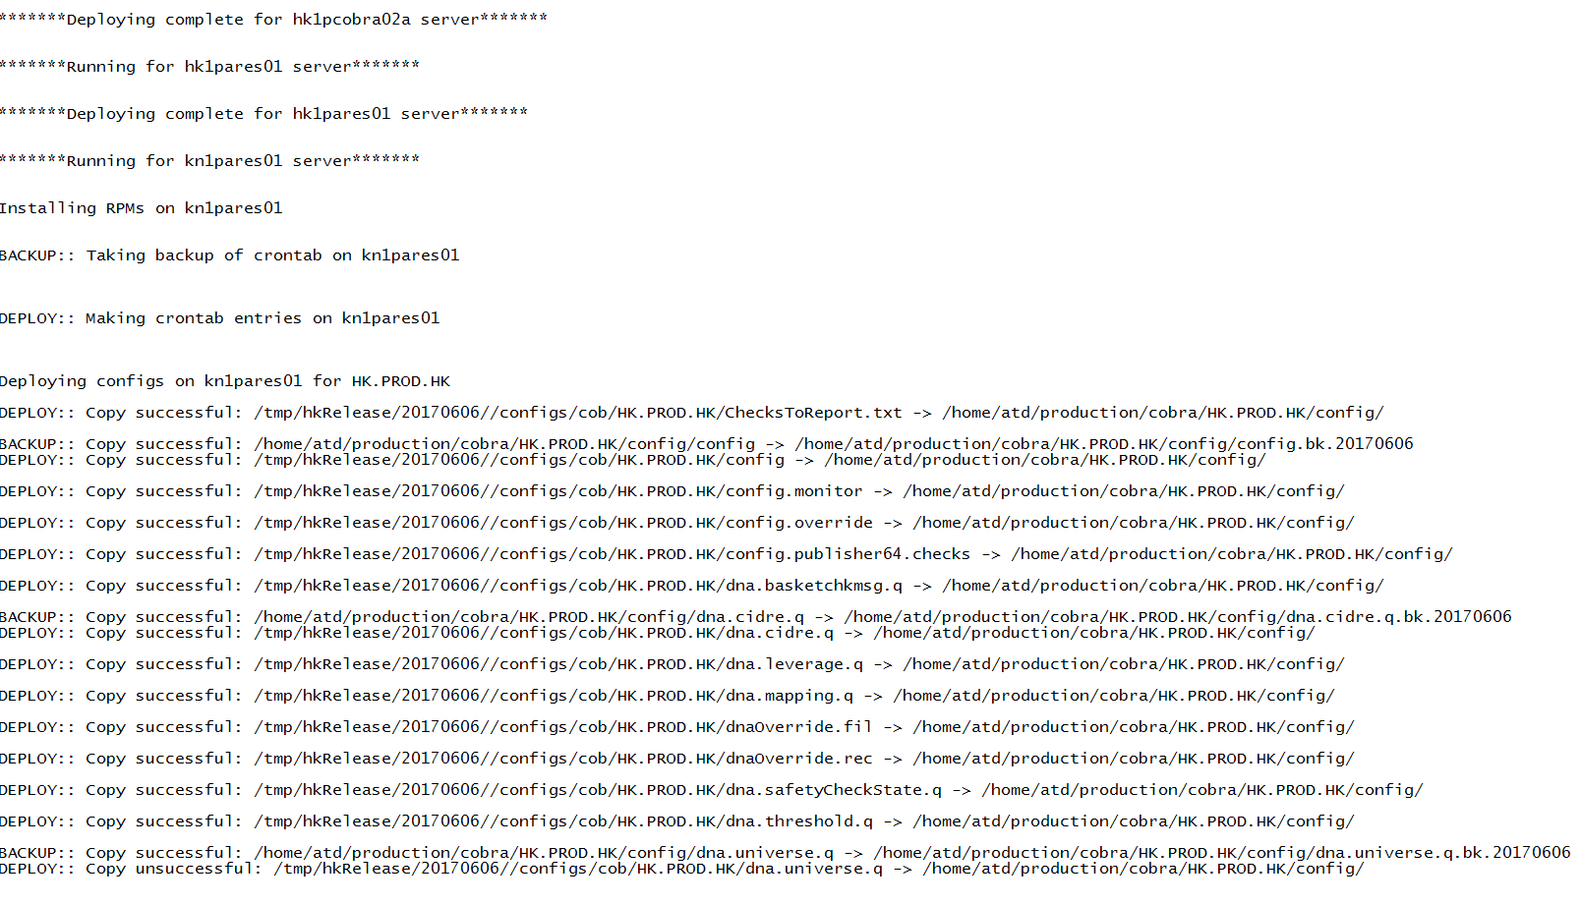
Screenshot of release logs
Notes:
Screenshot of release logs

Slide 9
Solutions continued…
The problem persisted on developer side.
Addressed it by writing a few helper scripts.
One of them was the Sync Script which synced the configs, scripts and files from all the instances running on all the servers through all three regions.
Created a Git repository for the same for keeping track.
Notes:
Still had to bring configs manually from all of them
The script took multiple parameters like region, environment, instance config and the destination
Used Rsync as primary method

Slide 10
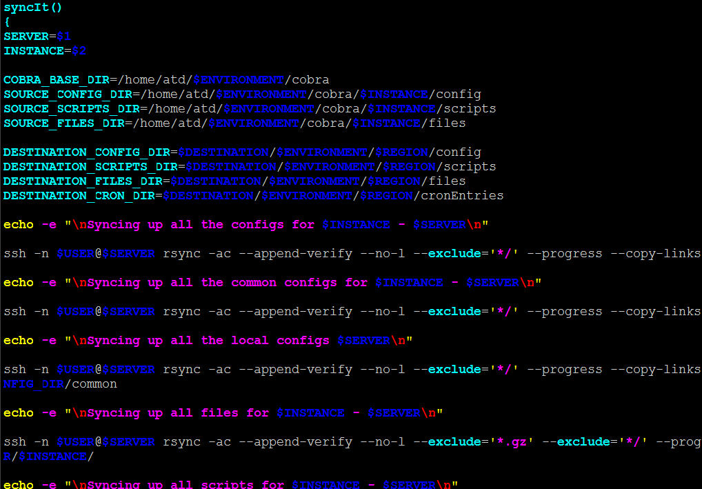
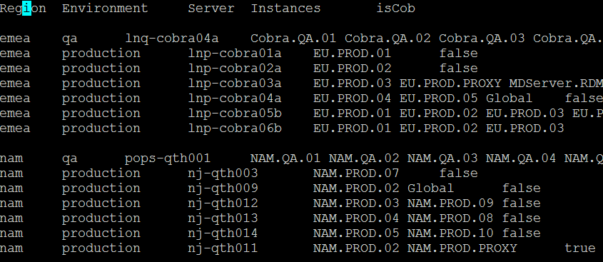
Screenshot of instance config
Screenshot of sync script
Screenshot of syncing process
Notes:
Screenshot of sync script, instance config and sync process

Slide 11
Solutions continued…
The next was the problem of making the entries in these synced configs.
This was solved by writing a couple of scripts called makeNewEntry and insertIntoConfig .
Overview of these scripts.
Notes:
The objective of makeNewEntry was that, that at the time of development if there is new entry in config, a developer can run this script by passing some parameters and it created a database of entries
The insertIntoConfig script took this database as source and made the corresponding entries in the configs based on the parameters.

Slide 12
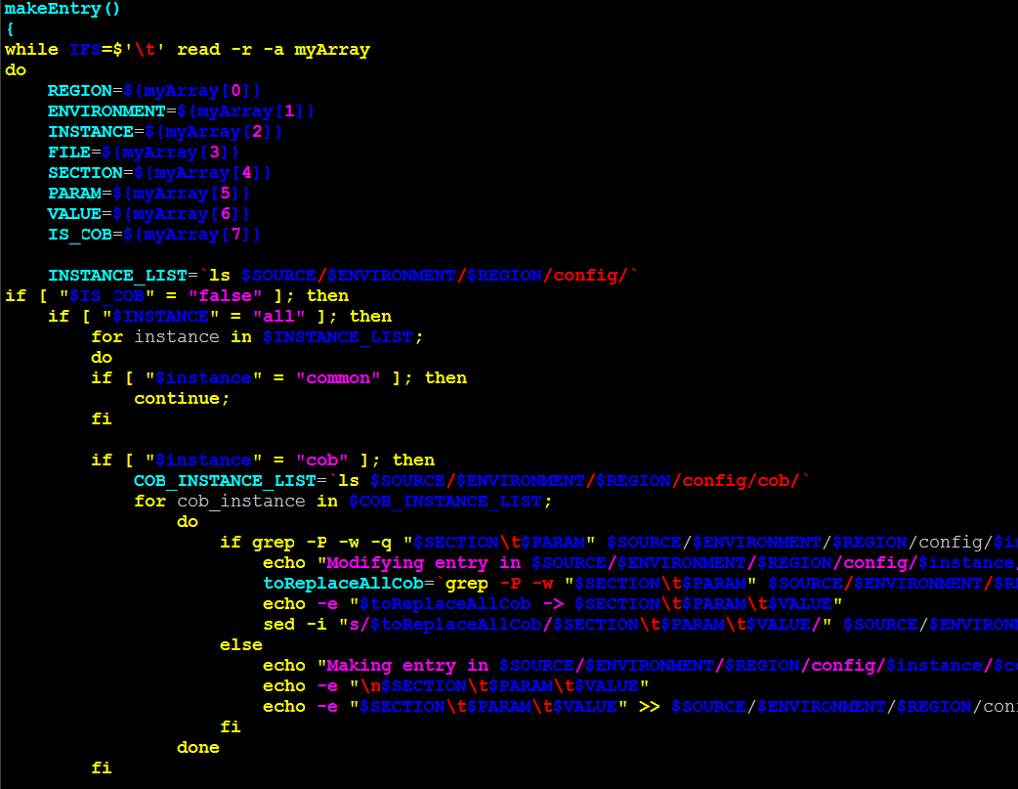
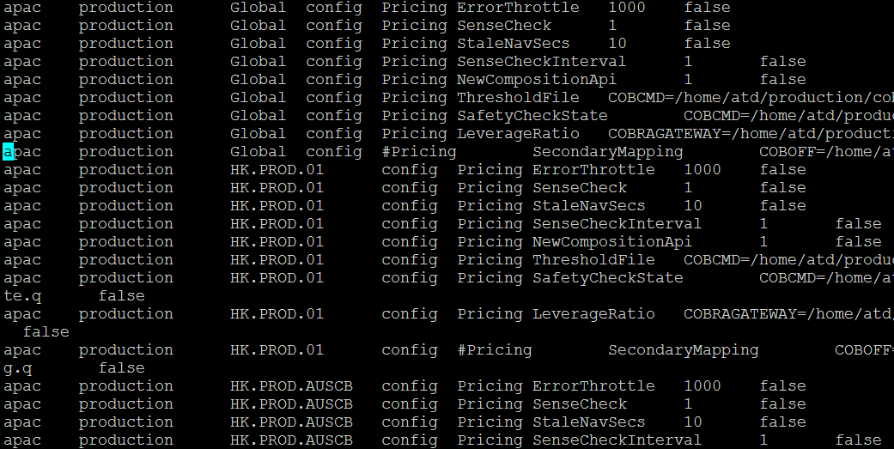
Screenshot of database
Screenshot of insertIntoConfig
Notes:
Screnshot of database and insert config

Slide 13
Solutions continued…
These scripts were still to be deployed through the release script and not via uDeploy.
As the final solution, I created a RPM for these configs and a separate component for the same in uDeploy.
Made a process to make directory structure such that the directories pointed to these installed RPM.
Notes:
Still needed to make the packet and was still not one click deployment.

Slide 14
Risks
The configs of a COBRA instance is the key for its proper functioning.
Changing even a small bit can be very troublesome and can cause huge loss.
This process improvement involves changing in the way configs are managed and hence possesses the same risk.

Slide 15
Status
Keeping in mind the risks involved, this change was a really tough to implement.
HK STI to CTI migration provided us with the best platform to test this change.
The process improvement was successfully tested in this migration.

Slide 16


